Slide 1
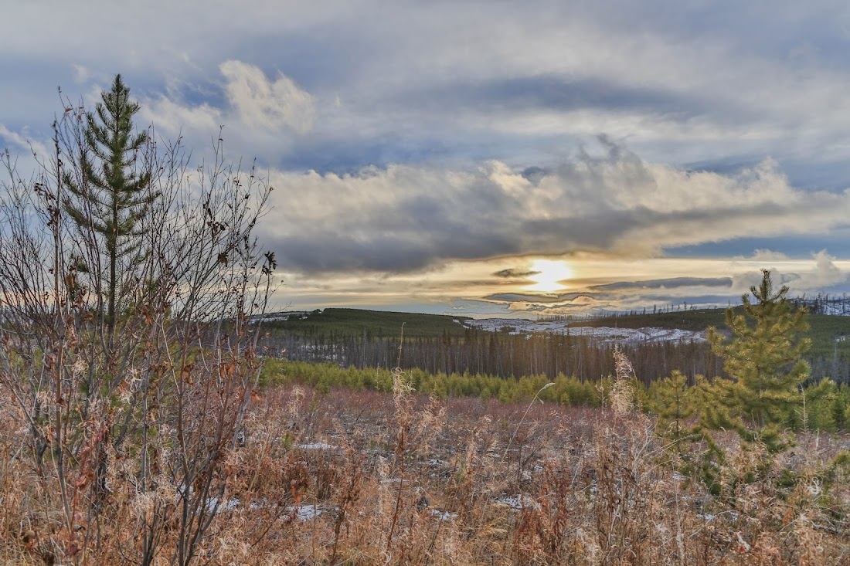
CACHE CREEK: WATER, LANDS, & DISASTERS
Disaster Mitigation and Lands Remediation January 2024

Slide 2
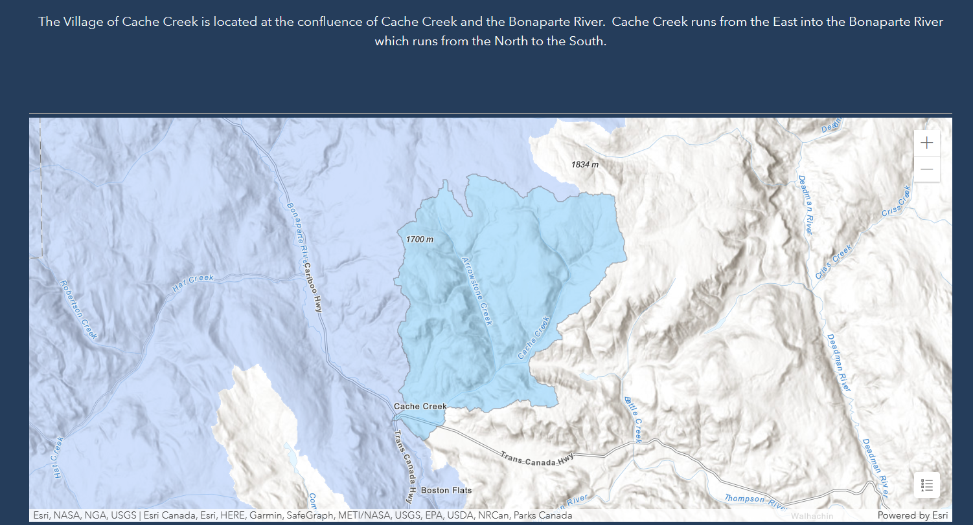
THE CACHE CREEK WATERSHED
Size: ~12,000 hectares
Aspect: South-facing
Condition: Devastated by 2017 Wildfire
Weather: Unknown (no station)
Precipitation: Unknown (no station)
Precipitation in Ashcroft: under 200mm annually
Flow Rate:
Cache Creek: Unknown (no station)
Arrowstone Creek: BC River Forecast Centre
Bonaparte River: BC River Forecast Centre
Feeds into: Bonaparte River, after passing through Village of Cache Creek; Thompson River, 10km South in Ashcroft

Slide 3
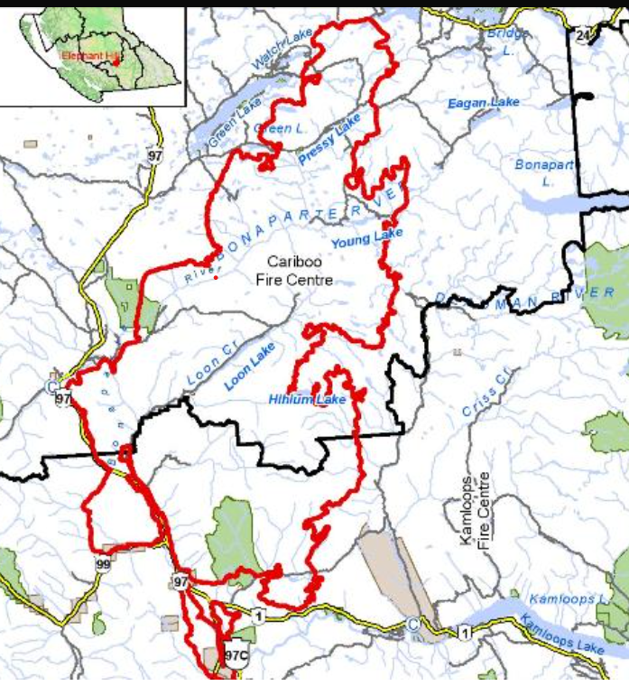
The 2017 Elephant Hill fire ripped through the Cariboo, burning 1920km2 (192,000 hectares), including entire neighbourhoods and residential developments, nearly the entire Cache Creek watershed, and much of the Bonaparte River watershed (483,000 hectares). The entire Village of Cache Creek was evacuated, as was much of the surrounding area.
The Village of Cache Creek was also subject to evacuation alerts due to two different wildfires in the area in two different months in 2021, and again to a wildfire in 2022.

Slide 4
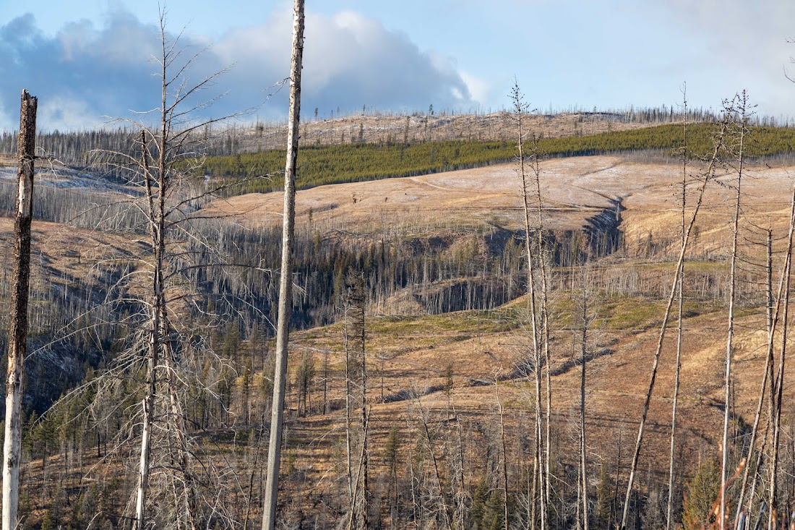
The South-facing Arrowstone Hills, looking North to the headwaters of Cache Creek
Photo by The Picture Miner
Fall 2023

Slide 5
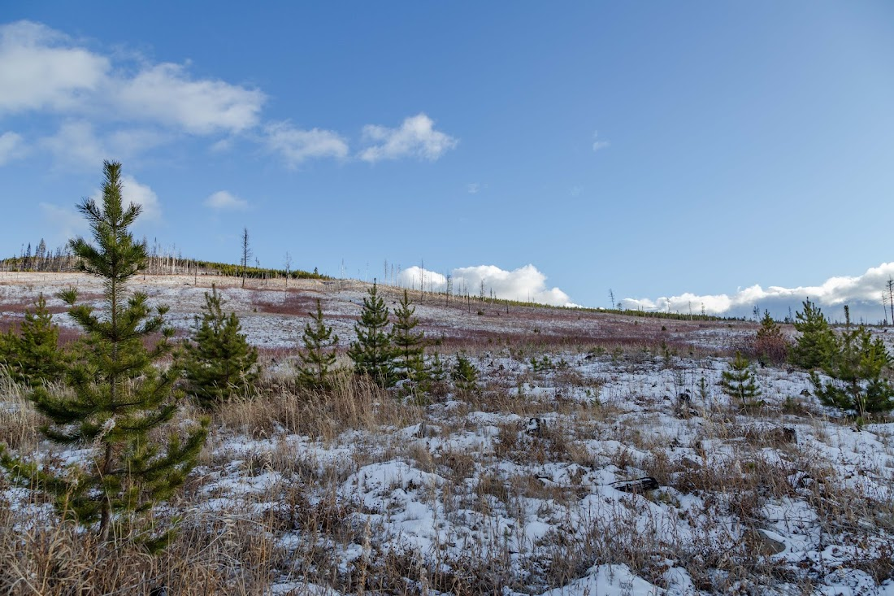
Looking North to the headwaters of Cache Creek
Photo by The Picture Miner,
Fall 2023

Slide 6
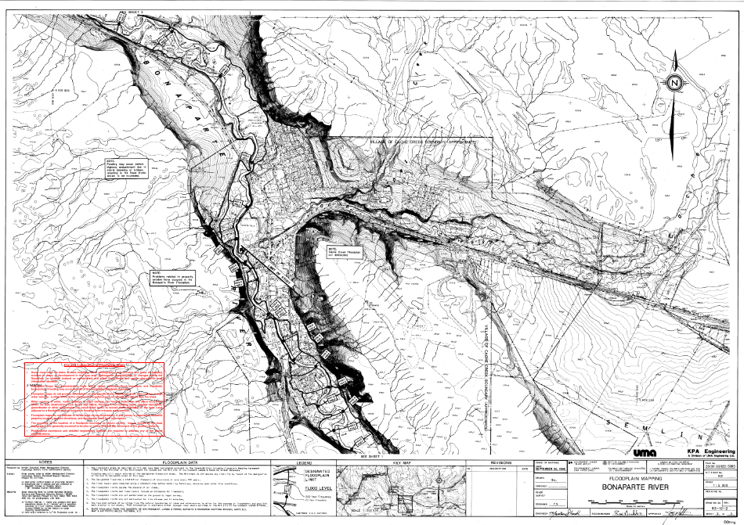
Floodplain Mapping of the Bonaparte River and Cache Creek waterways; KPA Engineering,1996.
Devastating flooding events in the Village of Cache Creek have been recorded in 1936, 1948, 1979, and 1990.
Over the last ten years, the Village experienced floods in 2013, 2015, 2017, 2018, 2019, 2020, 2021, and 2023. These events included flooding of both the Cache Creek and Bonaparte waterways, one waterway only, or were mudslide and/or flood events from flash rains or incredibly fast snowpack melts due to high Spring temperatures.

Slide 7
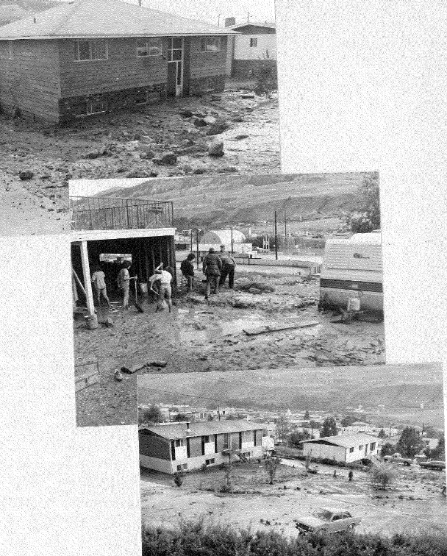
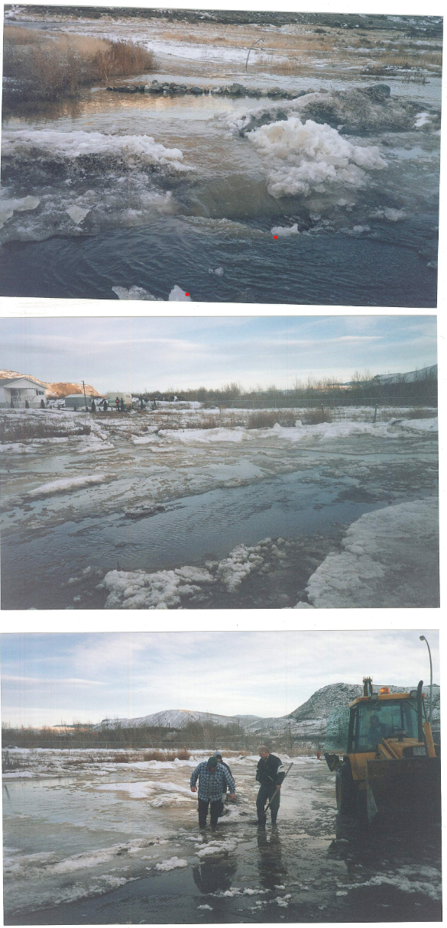
Floods due to
Rain Events
1979
1997
Village of Cache Creek Archive Photos, 1979 (L), 1997 (R)

Slide 8
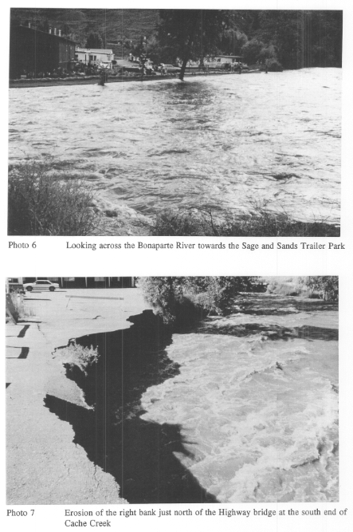
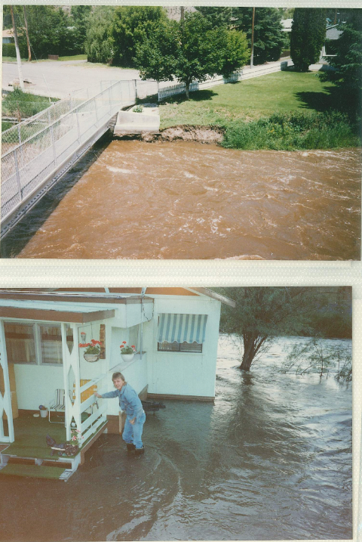
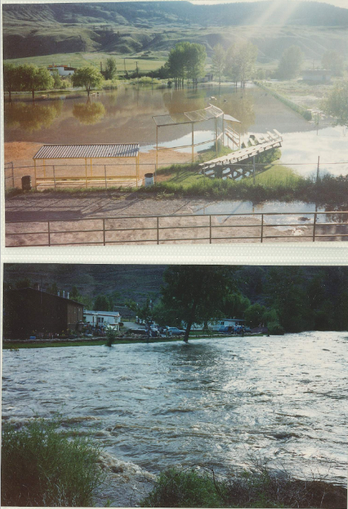
1990 Flood
KPA Engineering Report, 1996
Village of Cache Creek Archive Photos, 1990

Slide 9
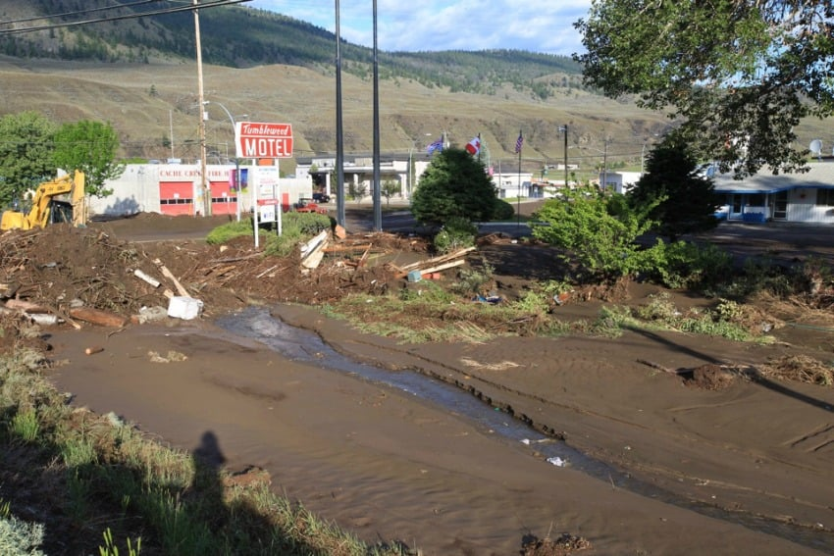
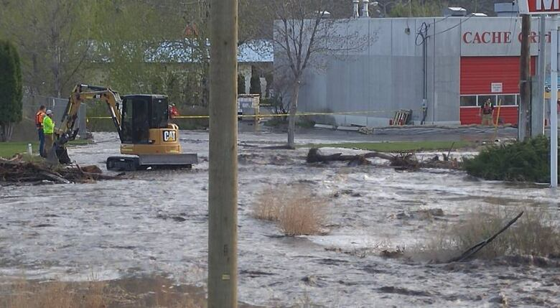
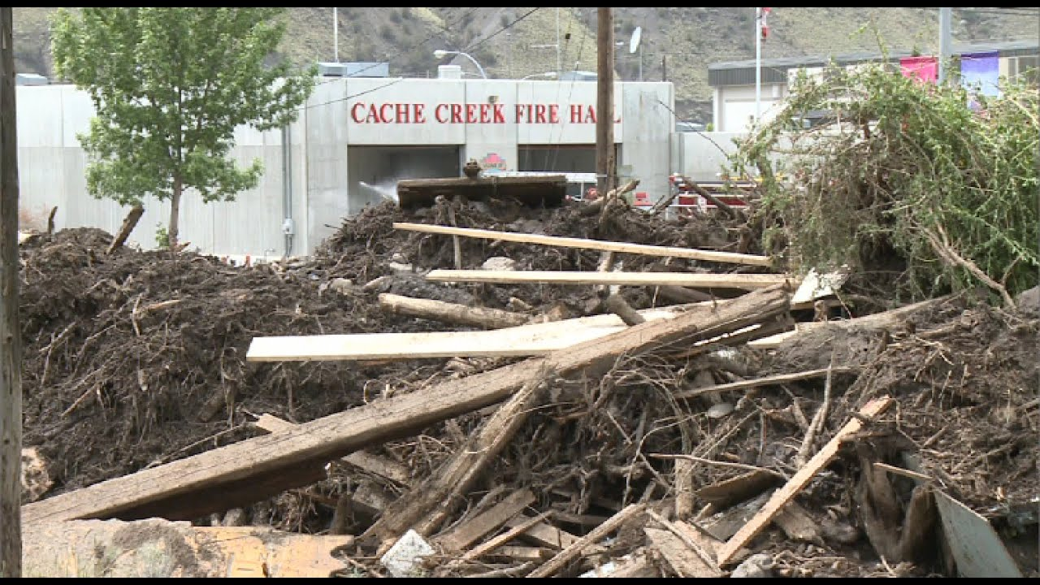
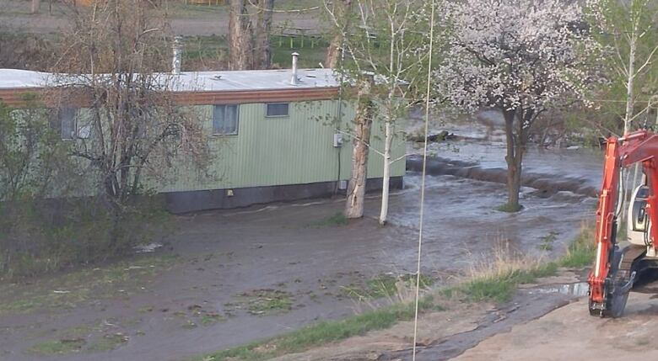
2015
2018
2017
In memory of Fire Chief Clayton Cassidy, who was swept away by the floodwaters. He is remembered with honour and integrity, a man who showed up with compassion and capability.

Slide 10
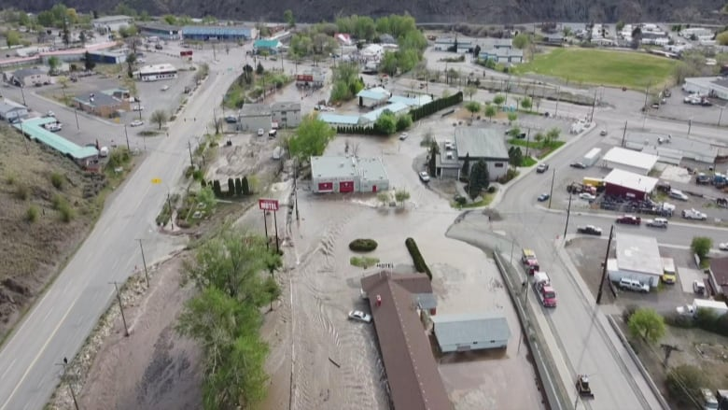
2023 Freshet Melt
& Spring Rains
50% of residents evacuated
+50% of businesses closed
+$15M in damages to civic, commercial, and private property
1 in 3 properties negatively affected
1 in 5 suffered damages considered a financial burden to repair
Village of Cache Creek
Population: 969
Population of Area I: ~6,000
Municipal Tax Base: $852,000 (2023)
Median income (after tax): $29,600
Median age: 57
Photo: Kevin Scharfenberg, 2023
Sources: Census 2021, Village records

Slide 11
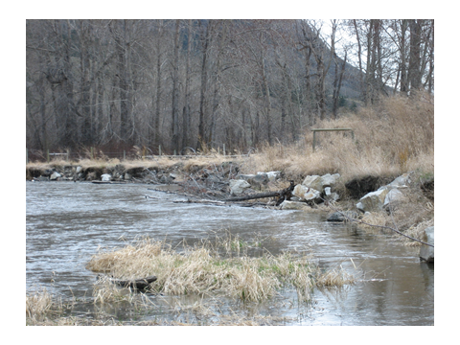
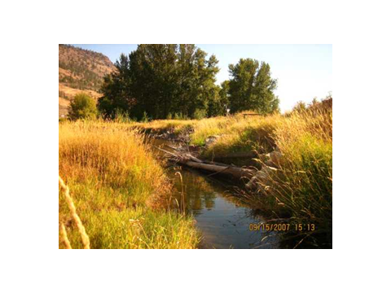
BONAPARTE WATERSHED STEWARDSHIP SOCIETY
Founded in 2000
Have completed instream works that slow the flow of water, prevent erosion, and support natural habitats
Value of works completed to date: +$750,000
+130 salmon habitat installations
Above: Before 2003
Needs:
Funding
Grants person
Administrator
Left:
After
2007
Funded by Pacific Salmon Foundation

Slide 12
STAKEHOLDERS IN THE WATERSHED
THANK YOU TO OUR COMMUNITY
The watershed is contained within lands managed by the following:
- Various ministries of the Province of BC
- Department of Fisheries & Oceans
- Thompson Nicola Regional District
- Secwepemc Nations
- Cattle ranchers, water license holders, and private landholders
- The Village of Cache Creek
Bonaparte Watershed Stewardship Society
Bonaparte First Nation
Residents and Businesses of the Village of Cache Creek
Fish & Wildlife Compensation Program for funding this session
For slides or more information, please contact recovery@cachecreek.ca

